Slide 1

Bird Species Detection
Prepared by:
Ankit Chhetri 30759
Ankrit Risal 30760
Bhaskar Subedi 30769
Supervised by:
Er. Laxmi Prasad Bhatt
Er. Ukesh Thapa
1

Slide 2
OVERVIEW
Introduction
Problem Statement
Project Objective
Features
System Requirements
Literature Review
System Design
Methodology
Results, Analysis and Conclusion
Limitation and Future Enhancement
2

Slide 3
INTRODUCTION
Birds are one of the most diverse groups of animals, with over 10,000 different species found in a wide range of habitats worldwide.
Birds are crucial for ecosystems and need conservation efforts.
Our study uses CNNs to classify bird species, aiding environmental research.
Deep learning, especially CNNs, helps researchers identify bird species
3

Slide 4
PROBLEM STATEMENT
Manual bird species identification is both tedious and error-prone, relying on an individual's limited knowledge and local expertise.
Current methods involving bird audio analysis are time-consuming and impractical for large-scale identification.
Bird classification is tough due to various appearances and backgrounds.
4

Slide 5
PROJECT OBJECTIVE
To accurately identify the bird species through image processing using convolution neural networks (CNNs).
5

Slide 6
FEATURES
AI-Based Detection
Prediction Displayed with Birds Scientific Name.
Nepali Name Displayed
Real Time Processing
6

Slide 7
SYSTEM REQUIREMENTS
Functional Requirements-
Bird identification: The system should allow the detection of different species of birds.
Bird Description: The system should have descriptions of different species of birds.
Non-Functional Requirements-
Accuracy: The system gives an accuracy greater than 75%.
Training Time: The estimated training time for the algorithm should be less.
Maintenance: The system should be easy to maintain and support.
Response time: Response time must be as quick as possible.

Slide 8
SYSTEM REQUIREMENTS
Hardware Requirements
Software Requirements
Multi-core CPU (e.g., quad-core).
NVIDIA GTX or AMD RX (GPU).
A fast SSD with sufficient capacity (e.g., 256 GB).
Language: Python
Pytorch
Web framework: Flask.
Numpy ,Sklearn and Matplotlib.
Frontend: HTML, CSS, and Javascript.
IDE: VS code, Jupyter Notebook
Operating System: Windows and Linux.

Slide 9
LITERATURE REVIEW
Fagerlund used machine learning algorithms (support vector machine, k nearest neighbor) to detect bird species [1].
CNN for image recognition is much more efficient in accuracy as well as performance compared to machine learning models [2].
Adam [3] trains the weight of the neural network using a separate learning rate for each weight parameter has more efficient and faster convergence rate than Stochastic Gradient Descent (SGD) [4].
Cross validation is an important hyper parameter tuning approach for training of the dataset and avoid overfitting and make the model more generalized [5].

Slide 10
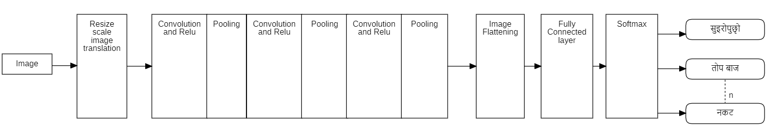
SYSTEM DESIGN

Slide 11
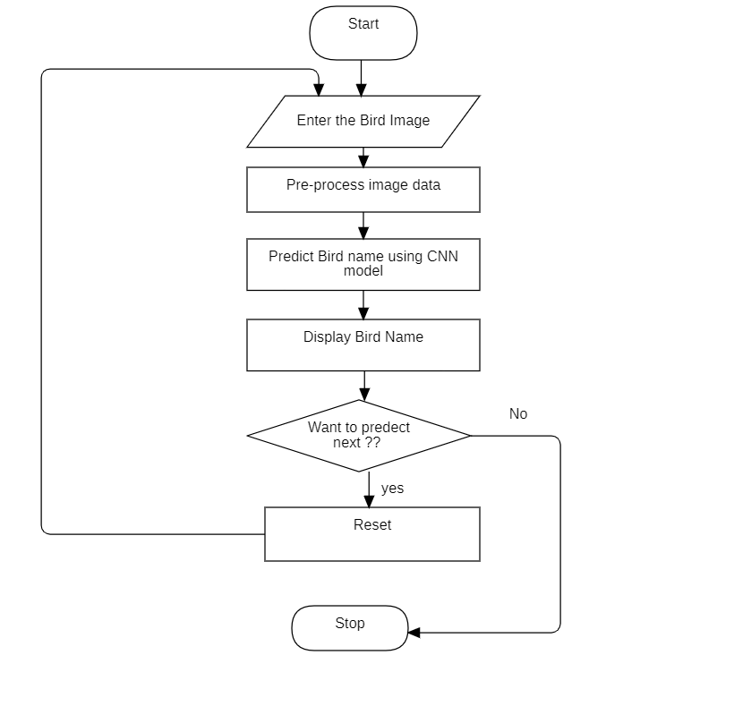
Figure: Flowchart

Slide 12
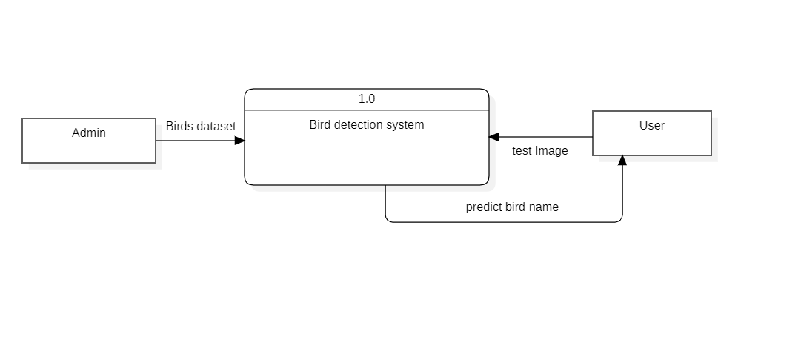
Figure: Level 0 DFD

Slide 13
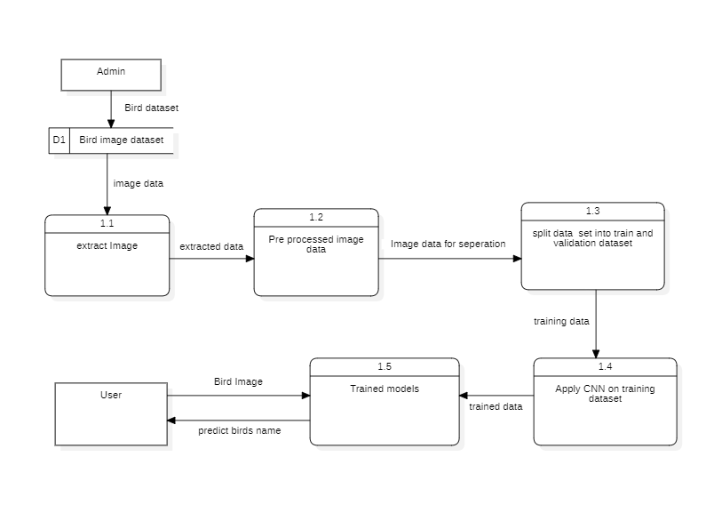
Figure: Level 1 DFD

Slide 14
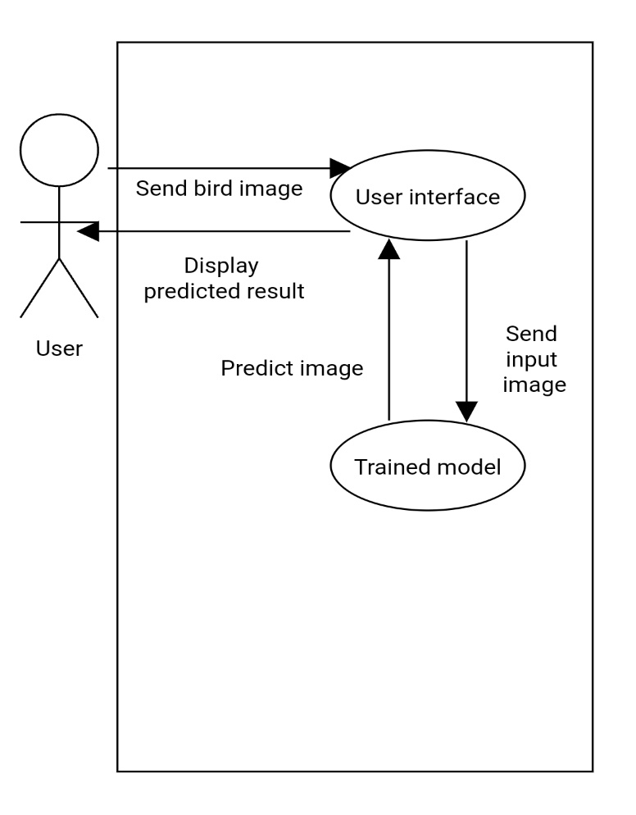
Figure: Usecase Diagram

Slide 15
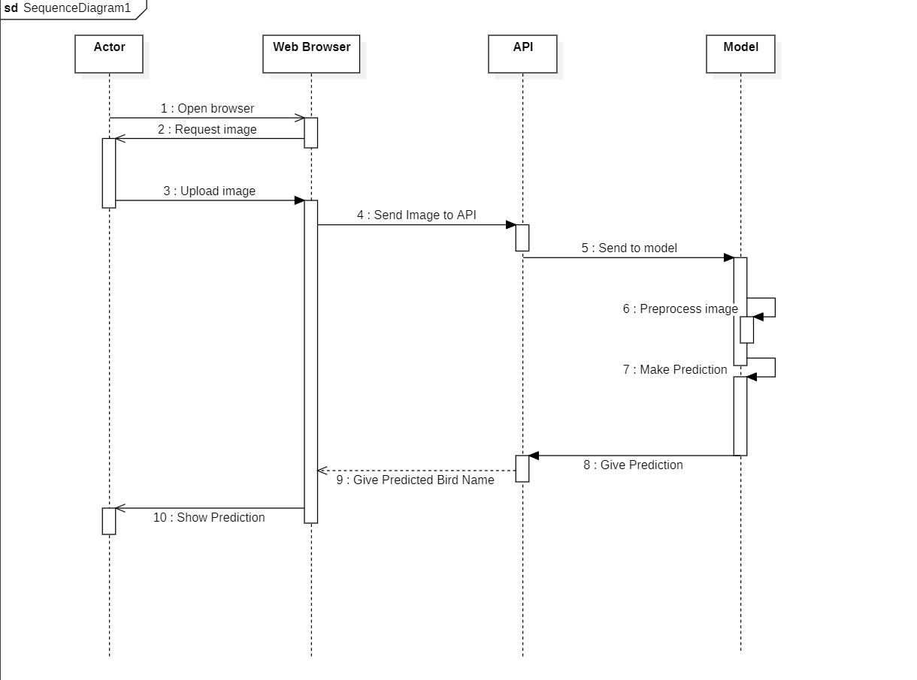
Figure: Sequence diagram

Slide 16
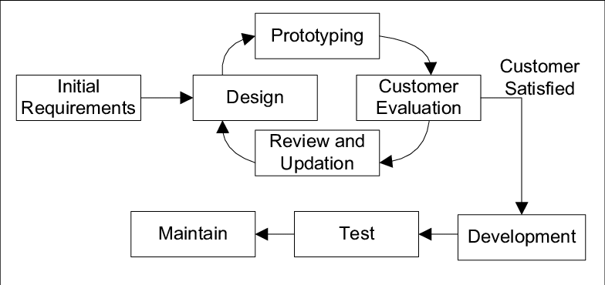
Methodology
Software Developmental model
Figure: Prototype model
Source: https://www.researchgate.net/figure/Prototype-Model-3_fig1_313786662

Slide 17
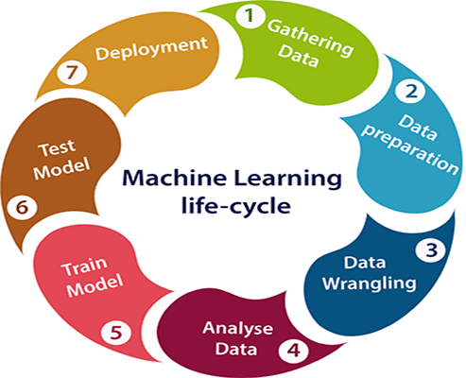
Machine Learning Algorithm
Figure: Machine learning lifecycle
[Source: https://www.javatpoint.com/machine-learning-life-cycle?fbclid=IwAR0WFP6AuXXYhizKOQConi51aFju5BiTndNV4tGHpQ-IValfEk2036cSHuo]

Slide 18
The following steps are followed in the machine learning life cycle:
Gathering data: 38 Species bird dataset was downloaded.
Data preparation: Images were split into train, test and validation.
Data wrangling: Data was augmented, pre-processed and changed into input form.
Analyze data: A classification model was selected for the project.
Train model: The model was trained with input data.
Test model: The model was tested using unseen data.
Deployment: A complete system was built by integrating with UI and API.

Slide 19
RESULT,ANALYSIS AND CONCLUSION
RESULT AND ANALYSIS
Dataset
We gained our dataset from internet as endangered bird species dataset. This dataset contains the data of 38 birds’ species with their scientific names and about 8073 images are there in training dataset and 402 images for testing dataset. We changed the name of each birds to unique labels so that we can map them to their respective Nepali names.
Result
Based on our codes and model design we have obtained different results on dataset. We have got the train accuracy as about 75% and Validation accuracy as 77%. Here is the accuracy graph of our model.

Slide 20
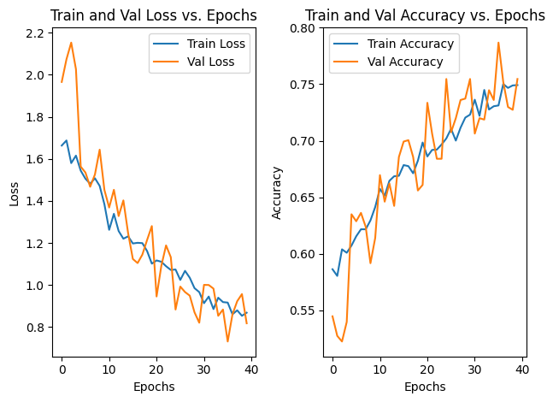
Figure: Train and validation losses and accuracy graph

Slide 21
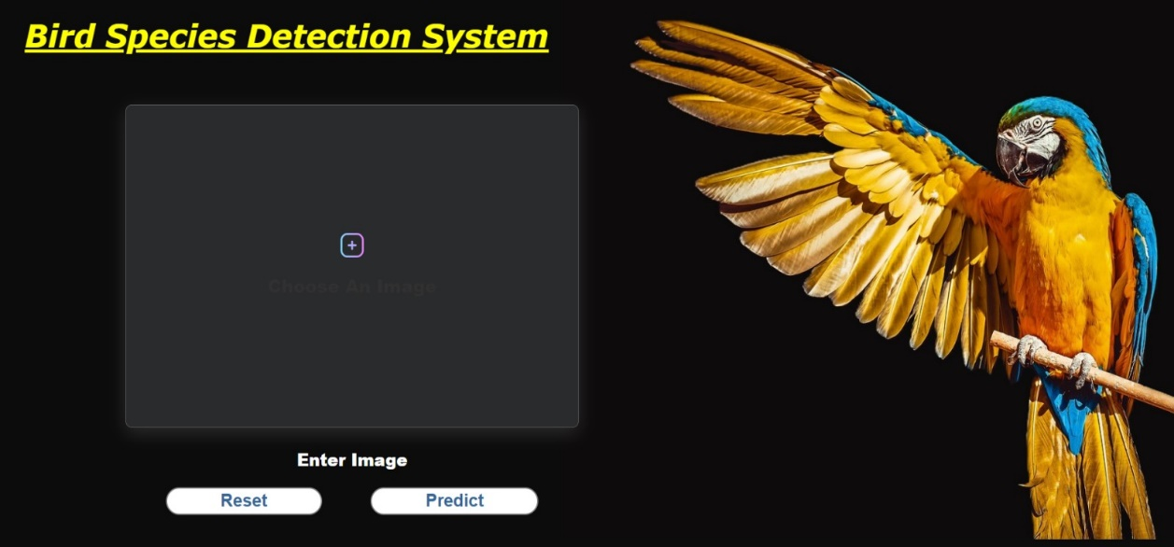
Result Obtained
Figure : User interface

Slide 22
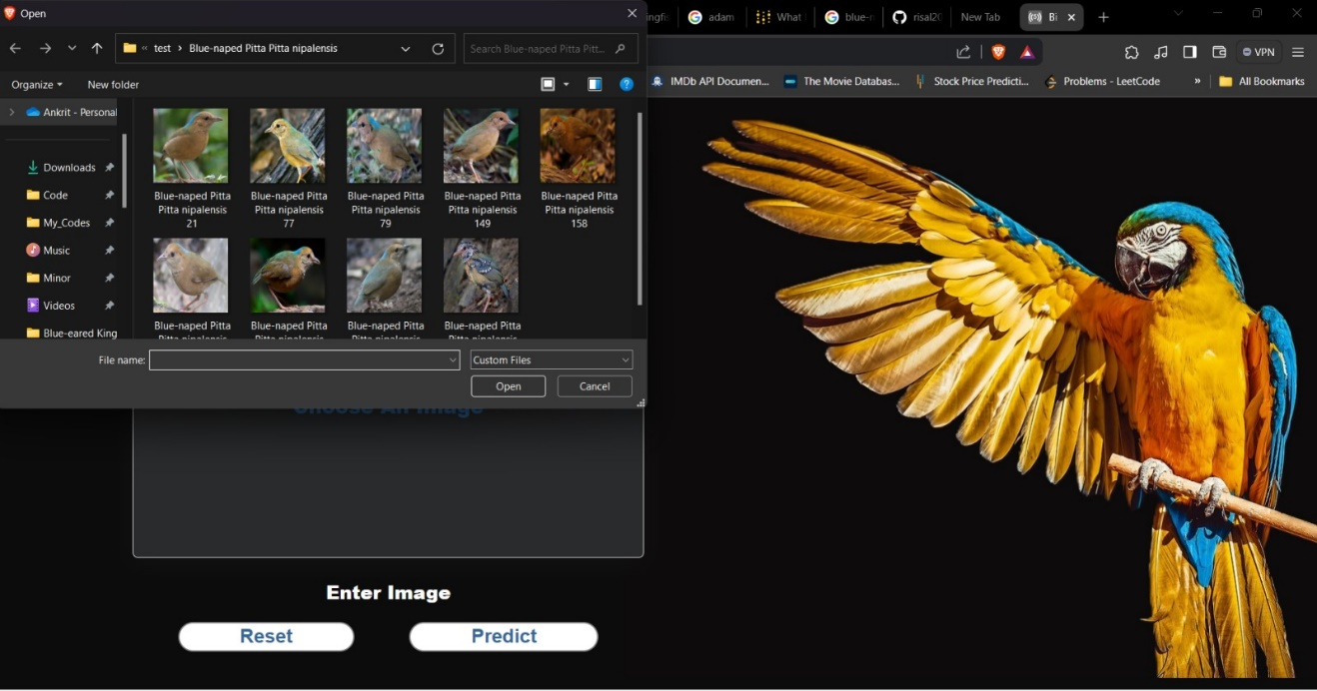
Figure: Upload Photo

Slide 23
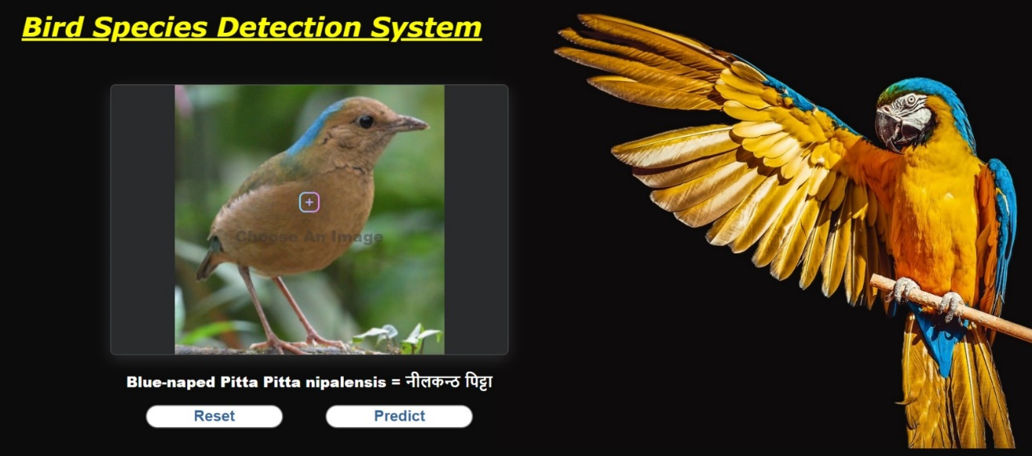
Figure: Bird Recognition

Slide 24
CONCLUSION
A Convolutional Neural Network (CNN) has been developed to accurately classify bird species from user-input images. Using this model we have achieved an accuracy of 77%. In this model we have integrated Cross-validation which helps to achieve higher accuracy and hyper-parameter tuning is done to identify the parameter values that is suitable for our model performance.

Slide 25
LIMITATIONS AND FUTURE ENHANCEMENTS
Limitations
There are a few drawbacks regarding bird species classification in our system:
Our model is based on a limited dataset (38 species only).
Cannot provide the correct information if more than one bird is present in a single picture.
Can give wrong information if the image is not clear.
Future Enhancements
Several possible future enhancements could be considered for the Bird Species Recognition System:
Collecting and using a larger, more recent dataset to train and evaluate the models.
Integrate information from audio recordings or environmental data.
Combine prediction from a variation of CNN models to improve performance.

Slide 26
REFERENCES
[1] Seppo Fagerlund,” Bird Species Recognition Using Support Vector Machines”, EURASIP Journal on Advances in Signal Processing volume 2007, Article number: 038637 (2007). Accessed: Dec. 19, 2023. [Online].
[2] LeCun, Y.; Boser, B.; Denker, J. S.; Henderson, D.; Howard, R. E.; Hubbard, W.; Jacker, L. D. (June 1990). "Handwritten digit recognition with a back-propagation network“. Accessed: Dec. 20, 2023. [Online].
[3] Diederik P. Kingma, Jimmy Ba ,” Adam: A Method for Stochastic Optimization”, Published as a conference paper at the 3rd International Conference for Learning Representations, San Diego, 2015. Accessed: Dec. 22, 2023. [Online].
[4] Sebastian Ruder, ” An overview of gradient descent optimization algorithms”, Insight Centre for Data Analytics, NUI Galway. Accessed: Dec. 19, 2023. [Online].
[5] Payam Refaeilzadeh, Lei Tang & Huan Liu, “Cross Validation”, Encyclopedia of Database Systems pp 532–538. Accessed: Dec. 21, 2023. [Online].
[6] “Volume 1 The Status of Nepal’s Birds: The National Red List Series.” Accessed: Dec. 19, 2023. [Online]. Available: https://cms.zsl.org/sites/default/files/2023-02/ZSL%20National%20Red%20List%20of%20Nepal%27s%20Birds%20Volume%201%202016.pdf

Slide 27
THANK YOU!

